Slide 1
Non-Negative Matrix Factorization(NMF)
Abimbola Oluwade 07/22/20

Slide 2
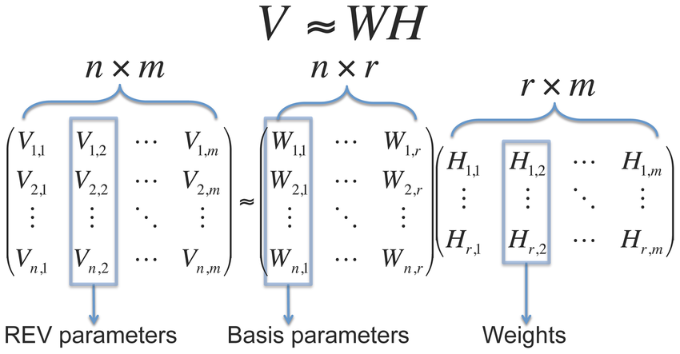
NMF as a dimension reduction technique
NMF is a dimension reduction technique like PCA, ICA, etc.
It is specifically a matrix factorizing technique which tends to reduce a matrix V (n_features × m_samples) down to W(n_features×r) and H(r×m_samples).
r is smaller than both n and m hence dimension reduction
Main idea: Find W and H such that

Slide 3

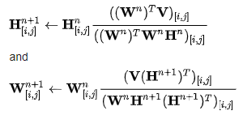
NMF Solution Implementation
NMF aims to find the best W and H by iteratively updating until its solution converges to a local minimum
Most common/efficient update is the multiplicative as opposed to the additive update
Two major NMF methods:
Frobenius Norm (most widely used)
Kullback-Leibler
Frobenius Norm
Minimize
Multiplicative Update:
Note that updates are done element-wise [i,j] and solution is not unique
(Similar to Euclidean Distance)
Coefficients

Slide 4
Scikit learn Implemention
V or X = (m_samples, n_features)
So W (m_samples,r_components) H(r_components,n_features)
Once we obtain an H(weights), another dataset can be transformed based on that weight to produce a W for such dataset
NMF in Scikit learn requires a priori knowledge of r
So how do we know the best r ???

Slide 5
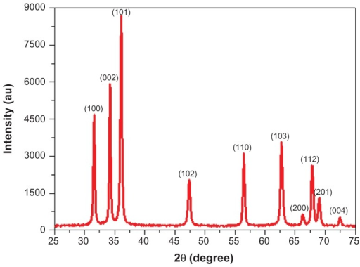

Application of NMF on XRD—Stanev et. al. Review
Stanev et. al. state that r can be visualized as the number of clusters/end members desired from a dataset
The weight matrix H(r,m_samples) signify the abundance of each phase in the composition map
Each intensity at a certain angle in a diffraction pattern can be represented just like a matrix multiplication aforementioned
Most important job is finding r
Note: Stanev et. al used k instead of r

Slide 6
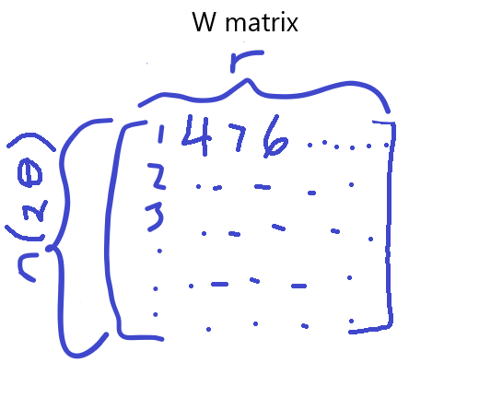
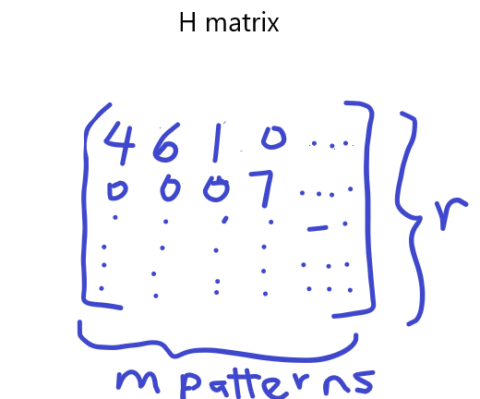
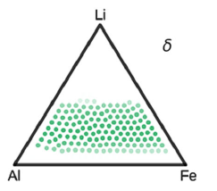
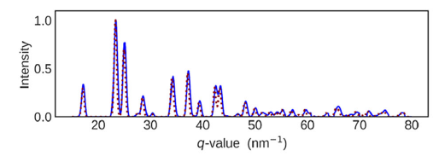
Phases and composition
Each column of the W matrix represent 1 cluster/phase
Each row of the H matrix represent the weight of each phase in the composition map

Slide 7
Methods (Stanev et. al.)
Utilize NMFk, an upgraded NMF that finds best r,W & H (this code apparently finds the optimal r)
NMFk MATLAB code available online free
Check for clusters that same but peak shifted
Construct the phase map from the H matrix

Slide 8
NMFk Optimal k Selection Procedure
Best k selection procedure by NMFk (refer to Stanev et. al. for full details)
Obtain many solutions, W&Hs, for a certain r (with r running from 1:n_samples)
NMFk uses custom clustering with cosine metric to estimate the quality of the solutions W&Hs in a certain rth possible cluster
For each rth possible cluster, the best W&H are found through Silhouette score and a percentage error
The best W&H from every rth cluster are compared and one with the lowest percentage error and highest Silhouette score is selected

Slide 9
Peak Shifting Identification
Peak Shifting identification procedures:
Max. shift should be 0.005 nm else it is another phase entirely—look at the patterns!
Compare the end member, column of W, representing these phase, w_{i} , w_{j} (where i ≠ j) using Pearson correlation. Correlation should be ≥ 0.97 for less noisy data and ≥ 0.90 for noisy data
The number of peaks from the diffraction patterns are equal (optional)

Slide 10
Phase Map
Phase map drawing procedures:
Obtain the abundance for each phase/cluster from the weight matrix(H)
For each composition point/single dot check the contribution/abundance from each phase and remove any phase contributing ≤ 1.2 (this threshold differs by characteristics of dataset)
Remove the least contributing until you have just 3 phases for every single dot (Gibbs’ rule)
Then plot every single dot/composition point

Slide 11
Questions

